Slide 1
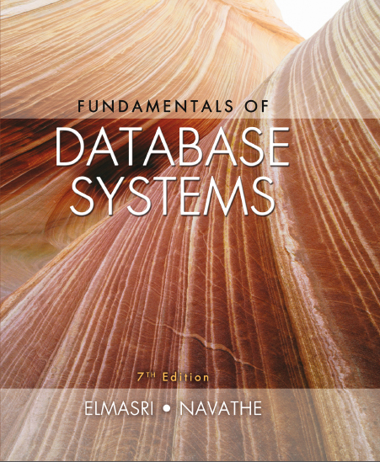
Fundamentals of Database Systems
Seventh Edition
Chapter 29
Overview of Data Warehousing and O L A P
Copyright © 2016, 2011, 2007 Pearson Education, Inc. All Rights Reserved
Notes:
If this PowerPoint presentation contains mathematical equations, you may need to check that your computer has the following installed:
1) MathType Plugin
2) Math Player (free versions available)
3) NVDA Reader (free versions available)

Slide 2
Learning Objectives
29.1 Purpose of Data Warehousing
29.2 Introduction, Definitions, and Terminology
29.3 Comparison with Traditional Databases
29.4 Characteristics of Data Warehouses
29.5 Classification of Data Warehouses
29.6 Data Modeling for Data Warehouses
29.7 Multi-dimensional Schemas
29.8 Building a Data Warehouse
29.9 Typical Functionality of a Data Warehouse
29.10 Data Warehouse vs. Data Views
29.11 Implementation difficulties and open issues

Slide 3
Introduction, Definitions, and Terminology (1 of 2)
Data Warehouse (D W) was proposed as a new type of database management system which would keep no transactional data but only summarized historical information for decision making purposes.
D W s are modeled and structured differently, use different techniques for storage and retrieval and cater to a different set of users.
W. H Inmon characterized a data warehouse as:
“A subject-oriented, integrated, nonvolatile, time-variant collection of data in support of management’s decisions.”

Slide 4
Purpose of Data Warehousing
Traditional databases are not optimized for data access - they have to balance the requirement of data access with the need to ensure integrity of data.
D W s provide access for complex analysis of data, knowledge discovery and decision support both through ad-hoc and canned queries.
Most of the times the data warehouse users need only read access but, need the access to be fast over a large volume of data.
Most of the data required for data warehouse analysis comes from multiple sources that may include databases from different data models and sometimes files acquired from independent systems and platforms.

Slide 5
Introduction, Definitions, and Terminology (2 of 2)
Data warehouses are databases that store and maintain analytical data separately from transaction-oriented databases for the purpose of decision support
Traditional databases support online transaction processing - O L T P.
Data Warehouses are for analytical applications- largely O L A P.
Applications that data warehouse supports are:
O L A P (Online Analytical Processing) is a term used to describe the analysis of complex data from the data warehouse.
D S S (Decision Support Systems) also known as E I S (Executive Information Systems) supports organization’s leading decision makers for making complex and important decisions.
Data Mining is used for knowledge discovery, the process of searching data for unanticipated new knowledge (See Chapter 28).

Slide 6
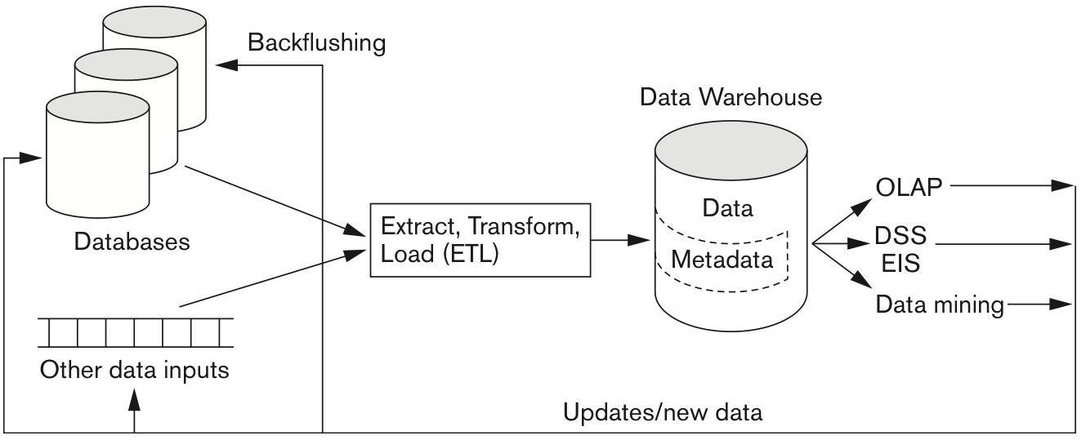
Conceptual Structure of Data Warehouse
Data Warehouse processing involves
Cleaning and reformatting of data
E T L (Extract, Transform, Load)
O L A P – Data Analytics
Data Mining
Figure 29.1 Overview of the general architecture of a data warehouse.

Slide 7
Comparison with Traditional Databases
Data Warehouses are mainly optimized for appropriate data access.
Traditional databases are transactional and are optimized for both transaction processing and integrity assurance.
Data warehouses emphasize more on historical data as their main purpose is to support time-series and trend analysis.
In transactional databases transaction is the mechanism of change to the database. By contrast, information in data warehouse is relatively coarse grained and D W s are regarded as non-real time. The periodic refresh policy is carefully chosen, usually incremental.
Compared with transactional databases, data warehouses are nonvolatile.

Slide 8
Characteristics of Data Warehouses
Based on Codd and Salley (1993) article on providing O L A P to users, the following characteristics of Data Warehouses were identified:
Multidimensional conceptual view
Unlimited dimensions and aggregation levels
Unrestricted cross-dimensional operations
Dynamic sparse matrix handling
Client-server architecture
Multiuser support
Accessibility
Transparency
Intuitive data manipulation
Inductive and deductive analysis
Flexible distributed reporting

Slide 9
Classification of Data Warehouses (1 of 2)
Generally, Data Warehouses are an order of magnitude larger than the source databases.
The sheer volume of data is an issue, based on which Data Warehouses could be classified as follows.
Enterprise-wide data warehouses
They are huge projects requiring massive investment of time and resources.

Slide 10
Classification of Data Warehouses (2 of 2)
Virtual data warehouses
They provide views of operational databases that are materialized for efficient access.
Logical Data Warehouses
Use data federation, distribution and virtualization techniques
Data marts
These are generally targeted to a subset of organization, such as a department, and are more tightly focused.

Slide 11
Other Concepts Common with Data Warehouses
O D S: – Operational Data Store : This term is commonly used for intermediate form of databases before they are cleansed, aggregated and transformed into a warehouse.
A D S – Analytical Data Store: these are databases built for analysis. Typically, O D S’s are reconfigured and repurposed into A D S’s.

Slide 12
Data Modeling for Data Warehouses (1 of 3)
Traditional Databases generally deal with two-dimensional data (similar to a spread sheet).
However, querying performance in a multi-dimensional data storage model (matrices) is much more efficient.
Data warehouses can take advantage of this feature as generally these are
Non volatile
The degree of predictability of the analysis that will be performed on them is high.
Typical Dimensions used in corporate D W s:
Fiscal Periods, Product Categories, Geographic Regions

Slide 13
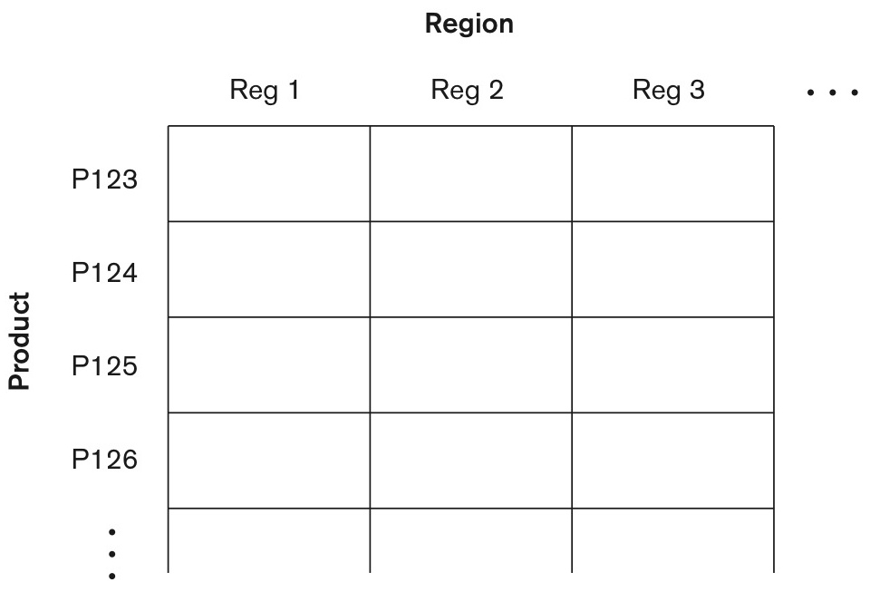
Data Modeling for Data Warehouses (2 of 3)
Example of Two- Dimensional vs. Multi-Dimensional (3D typically called “Data Cube”)
Figure 29.2 A two-dimensional matrix model.

Slide 14
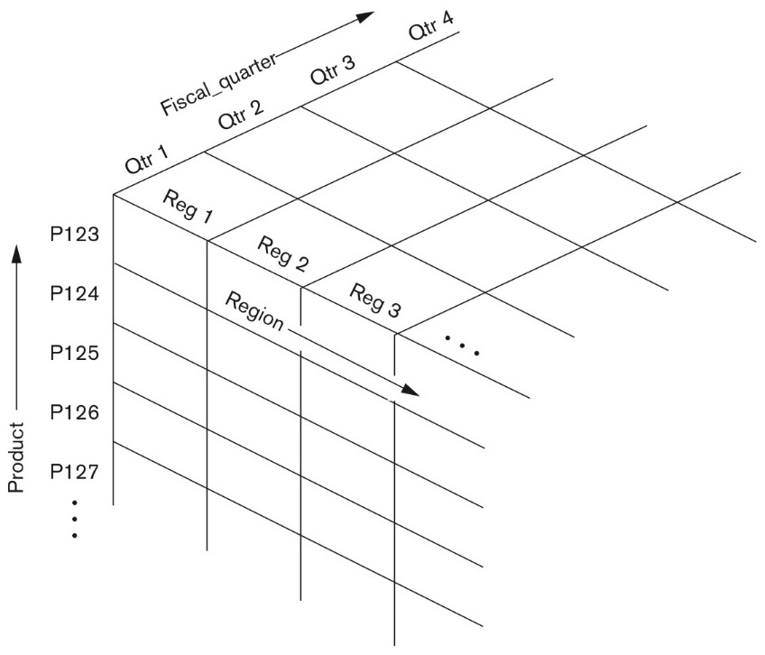
Data Modeling for Data Warehouses (3 of 3)
Figure 29.3 A three-dimensional data cube model.

Slide 15
Functionality of a Data Warehouse
Functionality that can be expected:
Pivot: Cross tabulation (also referred to as rotation) is performed.
Roll-up (also Drill-up): Data is summarized with increasing generalization (for example, weekly to quarterly to annually).
Drill-down: Increasing levels of detail are revealed (the complement of roll-up).
Slice and dice: Projection operations are performed on the dimensions.
Sorting: Data is sorted by ordinal value.
Selection: Data is filtered by value or range.
Derived (computed) attributes: Attributes are computed by operations on stored and derived values.

Slide 16
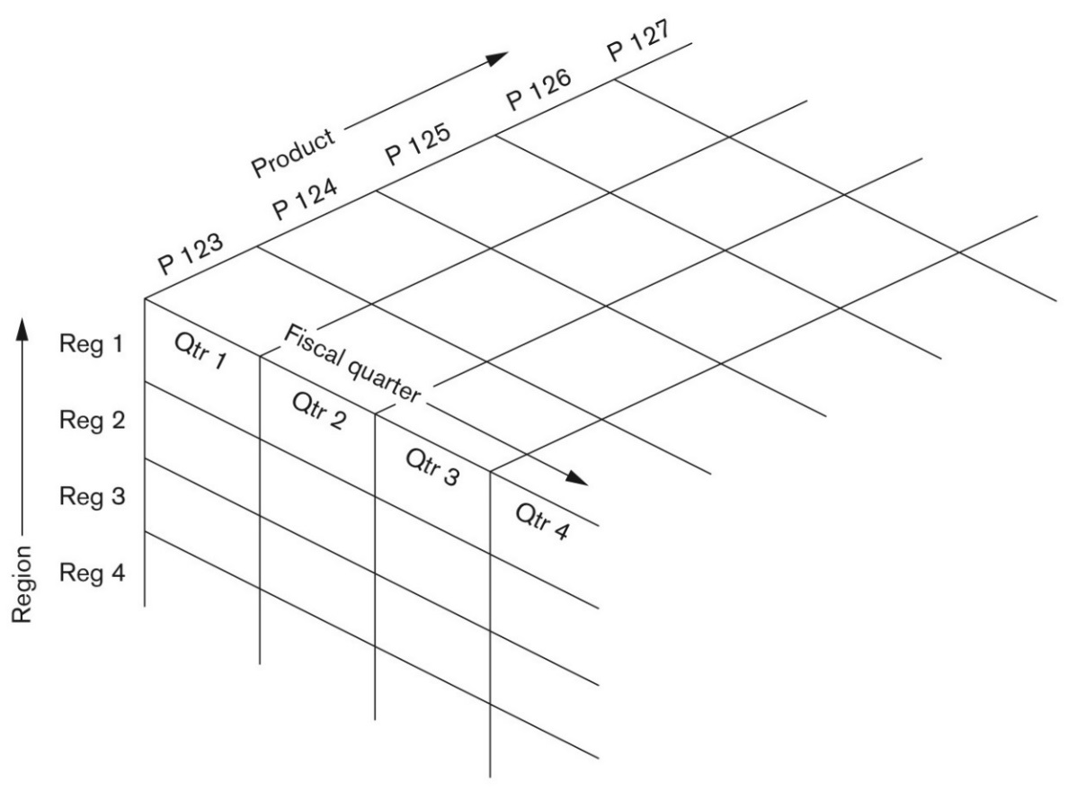
The Pivot Operation in a Data Warehouse
Figure 29.4 Pivoted version of the data cube from Figure 29.3 (see slide 14).
This presents data in terms of Region vs. Fiscal Quarter : product by product. “Pivoting” is also called as “Rotation”

Slide 17
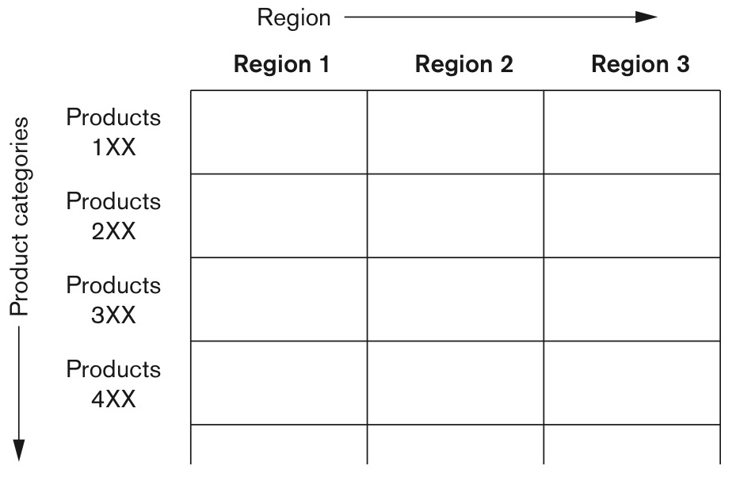
The “Roll-Up” Operation in a Data Warehouse
Figure 29.5 The roll-up operation.
The roll-up in above figure aggregates data for all products numbered 123, 124, …… into 1XX, etc.

Slide 18
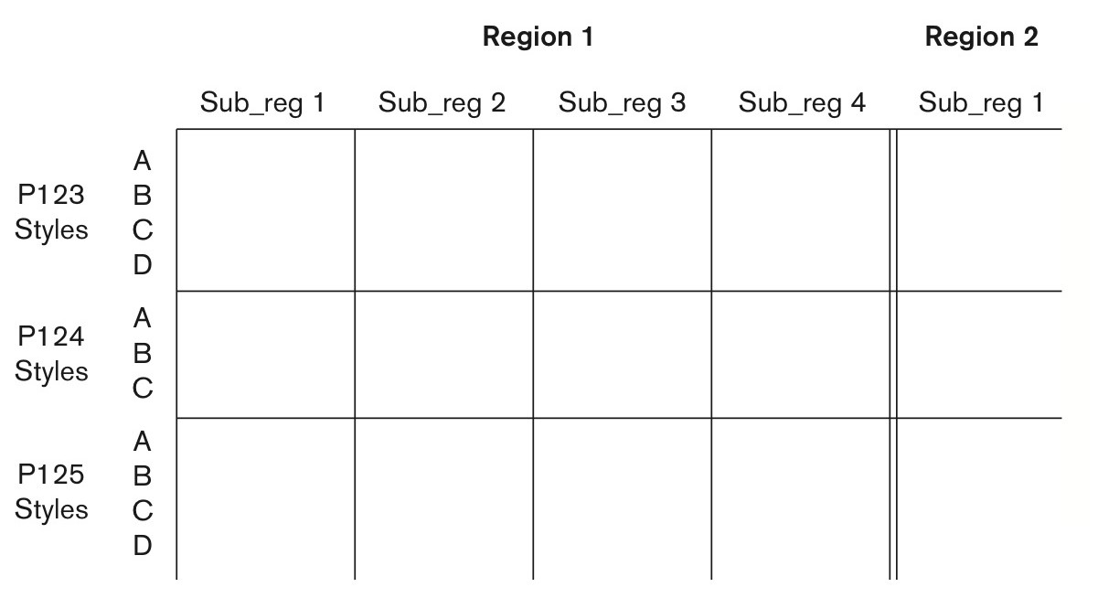
The “Drill-Down” Operation in a Data Warehouse
Figure 29.6 The drill-down operation.
A drill-down expands aggregate data into a finer grained view. In this example, products are divided into styles and regions into sub-regions.

Slide 19
Multi-Dimensional Schemas (1 of 6)
Multi-dimensional model (also called ”dimensional model”) includes two types of tables:
Dimension table
It consists of tuples of attributes of the dimension.
Fact table
Each tuple is a recorded fact. This fact contains some measured or observed variable (s) and identifies it with pointers to dimension tables. The fact table contains the data, and the dimensions to identify each tuple in the data.
A fact table is as an agglomerated view of transaction data whereas each dimension table represents “master data” that those transactions belonged to.

Slide 20
Multi-Dimensional Schemas (2 of 6)
Multidimensional D W systems implemented the multidimensional model as is.
The more popular approach is to implement the multidimensional model on top of the relational model.
Two common multi-dimensional schemas are
Star schema:
Consists of a fact table with a single table for each dimension
Snowflake Schema:
It is a variation of star schema, in which the dimensional tables from a star schema are organized into a hierarchy by normalizing them.

Slide 21
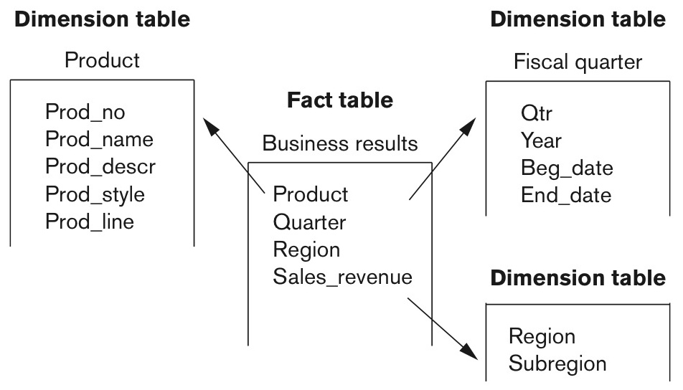
Multi-Dimensional Schemas (3 of 6)
Star schema:
Consists of a fact table with a single table for each dimension.
Figure 29.7 A star schema with fact and dimensional tables.

Slide 22
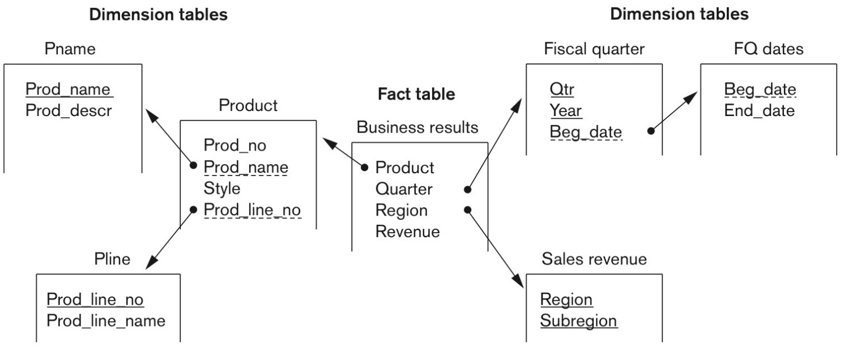
Multi-Dimensional Schemas (4 of 6)
Snowflake Schema:
It is a variation of star schema, in which the dimensional tables from a star schema are organized into a hierarchy by normalizing them.
Figure 29.8 A snowflake schema.

Slide 23
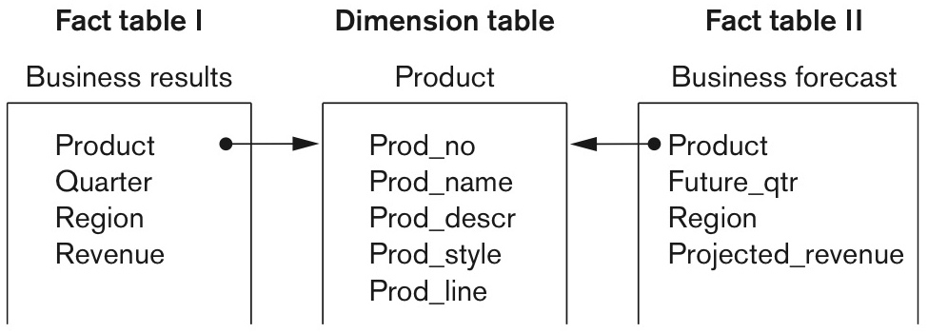
Multi-Dimensional Schemas (5 of 6)
Fact Constellation
Fact constellation is a set of tables that share some dimension tables. However, fact constellations limit the possible queries for the warehouse.
Example shows the Product dimension table being shared by two Fact tables.
Figure 29.9 A fact constellation.

Slide 24
Multi-Dimensional Schemas (6 of 6)
Indexing
Data warehouse also utilizes indexing to support high performance access.
A technique called bitmap indexing constructs a bit vector for each value in the domain being indexed.
Indexing works very well for domains of low cardinality. (See example of using a bitmap index in Section 19.8)
Master Data Management (M D M)
Purpose of M D M is to define standards, processes, policies and governance issues related to critical data elements entities of the organization

Slide 25
Building A Data Warehouse (1 of 2)
The builders of Data warehouse should take a broad view of the anticipated use of the warehouse.
The design should harmonize dimensions across the whole enterprise and multiple data sources
The design should support ad-hoc querying
An appropriate schema should be chosen that reflects the anticipated usage and the business model of the organization.

Slide 26
Building A Data Warehouse (2 of 2)
The Design of a Data Warehouse involves following steps.
Acquisition of data for the warehouse.
Ensuring that Data Storage meets the query requirements efficiently.
Giving full consideration to the environment in which the data warehouse resides.

Slide 27
Data Acquisition (1 of 2)
Acquisition of data for the warehouse
The data must be extracted from multiple, heterogeneous sources.
Data must be formatted for consistency within the warehouse.
The data must be cleaned to ensure validity.
Difficult to automate cleaning process.
Back flushing: refers to upgrading the source data by returning cleaned data.

Slide 28
Data Acquisition (2 of 2)
The data must be fitted into the data model of the warehouse. Data may have to be converted from its source model into a multi-dimensional format.
The data must be loaded into the warehouse.
Proper design for refresh policy should be considered.
Data may come from different systems, language areas and time-zones.
Order of loading is critical and semantic constraints must be obeyed.

Slide 29
Storing Data in a Data Warehouse
Storing the data according to the data model of the warehouse
Creating and maintaining required data structures
Creating and maintaining appropriate access paths
Providing for time-variant data as new data are added
Supporting the updating of warehouse data.
Refreshing the data
Purging data

Slide 30
D W Design Considerations
Usage projections
The fit of the data model
Characteristics of available resources
Design of the metadata component
Modular component design
Design for manageability and change
Considerations of distributed and parallel architecture
Distributed D W s: Replication, Partitioning, Communication, Consistency issues
Federated D W s : Decentralized federation of autonomous D W s.

Slide 31
Metadata Repositories
The metadata repository is a key data warehouse component. It includes both technical and business metadata.
technical metadata, covers details of acquisition, processing, storage structures, data descriptions, warehouse operations and maintenance, and access support.
business metadata, includes the relevant business rules and organizational details supporting the warehouse.

Slide 32
Functionality of Data Warehouses
We already presented operations of Pivot, Roll-up, Drill-down, etc.
Other functions include-
intersection and union of indexes
S Q L extensions for aggregation
Advanced join techniques for star schemas
Among O L A P functions, we have:
R O L A P : Relational O L A P – keeping D W as a relational D B
M O L A P: O L A P on multidimensional model
H O L A P: Hybrid O L A P –combines the above two. H O L A P can “drill-through” the data to underlying relations.

Slide 33
Data Warehouse vs Data Views
Views and data warehouses are alike in that they both have read-only extracts from the databases.
However, data warehouses are different from views in the following ways:
Data Warehouses exist as persistent storage instead of being materialized on demand.
Data Warehouses are not just relational, but rather multi-dimensional with multiple levels of aggregation.
Data Warehouses can be indexed for optimal performance. Views cannot be indexed directly.
Data Warehouses provide specific support of functionality.
Data Warehouses deals with large volumes of integrated data that is contained generally in more than one database.
Data warehouses bring in data periodically from multiple sources via a complex E T L process. Views do not go through cleaning and pruning.

Slide 34
Difficulties of Implementing Data Warehouses
Lead time is huge in building a data warehouse
Potentially it takes years to build and efficiently maintain a data warehouse.
Both quality and consistency of data as well as master data management are major concerns.
Revising the usage projections regularly to meet the current requirements.
The data warehouse should be designed to accommodate addition and attrition of data sources without major redesign
D W schema and acquisition component must handle the changes in data sources in terms of structure and content.
Administration of data warehouse would require far broader skills than are needed for a traditional database.

Slide 35
Open Issues in Data Warehousing
Data cleaning, indexing, partitioning, and views could be given new attention with perspective to data warehousing.
Automation of
data acquisition
data quality management
selection and construction of access paths and structures
self-maintainability
functionality and performance optimization
Incorporating of domain and business rules appropriately into the warehouse creation and maintenance process more intelligently.
Creating appropriate teams of technical experts that also understand the business.

Slide 36
Future of Data Warehousing (1 of 2)
Businesses are getting dissatisfied with the traditional data warehousing techniques and technologies.
New analytic requirements are driving new analytic appliances such at I B M Netezza, E M C Greenplum, S A P Hana and ParAccel.
Big data analytics have driven Hadoop and other specialized data bases such as graph and key-value stores into the next generation of data warehousing (see Chapter 25 for Big Data technology based on Hadoop).
Data virtualization platforms such as the one from Cisco will enable such Logical Data Warehouses to be built in future
See Description of Cisco’s Data Virtualization Platform at http://www.compositesw.com/products-services/data-virtualization-platform/

Slide 37
Future of Data Warehousing (2 of 2)
Gartner reports, a prestigious source of guidance for industry says:
“the Logical Data Warehouse (L D W) is a new data management architecture for analytics which combines the strengths of traditional repository warehouses with alternative data management and access strategy. The L D W will form a new best practices by the end of 2015.”
The term “Logical Data Warehouse” is a clear demarcation between centralized repository approaches and managed data services for analytics.
See: https://www.gartner.com/doc/2057915/understanding-logical-data-warehouse-emerging

Slide 38
Recap
Purpose of Data Warehousing
Introduction, Definitions, and Terminology
Comparison with Traditional Databases
Characteristics of data Warehouses
Classification of Data Warehouses
Data Modeling for Data Warehouses
Multi-dimensional Schemas
Building A Data Warehouse
Functionality of a Data Warehouse
Warehouse vs. Data Views
Implementation difficulties, open issues, and future.

Slide 39

Copyright

